Slide 1
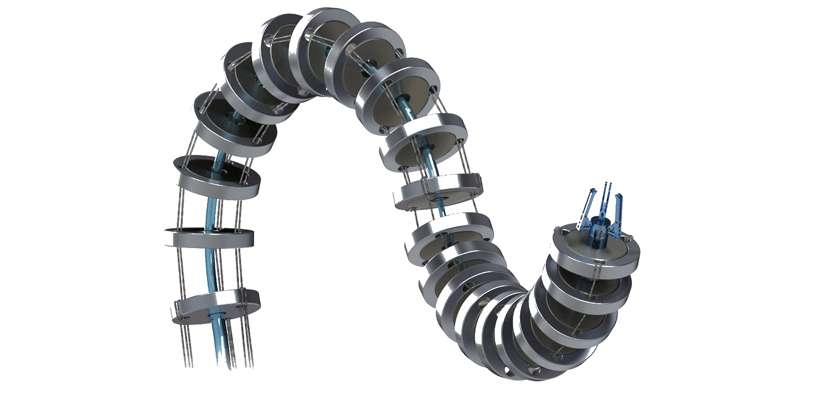
Luca Ricci Franco Angelini Michele Pierallini`
Continuum robot design and control

Slide 2
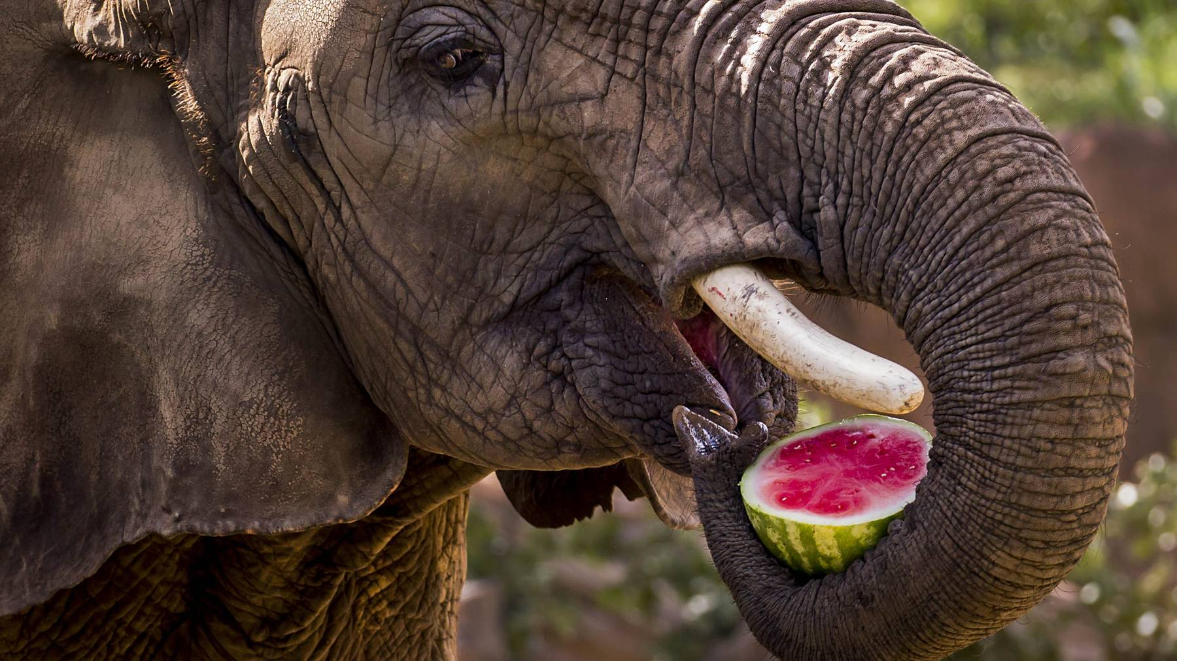

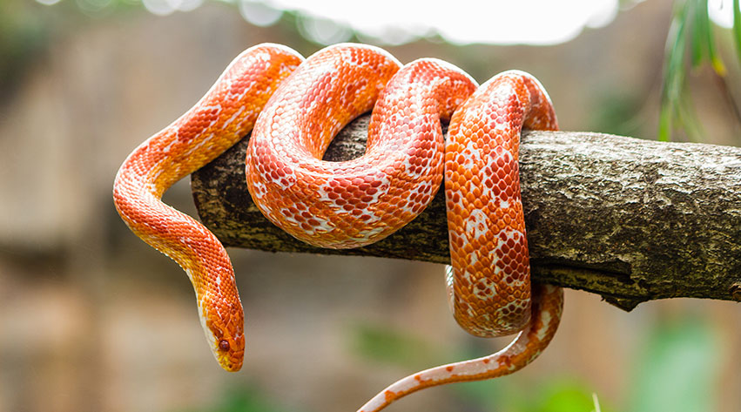
Motivations
Continuum robots are an increasingly popular class of manipulators characterized by their ability to assume continuous curved shapes.
The concept of continuum robot is indeed inspired by biological entities like octopus tentacles, snakes, trunks ...
Structures like these are charaterized by remarkable dexterit, elastic behavior and soft interaction with environment; because of that, thees robots can perform some tasks like grasping and space tasks in a better way respect classical rigid robots.
Thinking for example of tasks such as sliding in a tube or handling of delicate objects; we can imagine that curved and soft robots could accomplish these tasks with less complexity and because of that it may be interesting to study in more depth the model and the control of these type of robot .
We want to include in our project new hardware solution like new type of degrees of freedom respect classical approach and 3d printed soft materials. These hardware additions can bring significant benefits in the development of continuous robots that are predominantly soft.

Slide 3
Presentation Outline
Design robot section as a “case study”
Define a kinematics model of 3 DOF continuum section
Define closed dynamics model of 2 section continuum robot
Stability analyses
Single section dynamics simulation
Workspace analyses
Control of the soft continuum manipulator

Slide 4

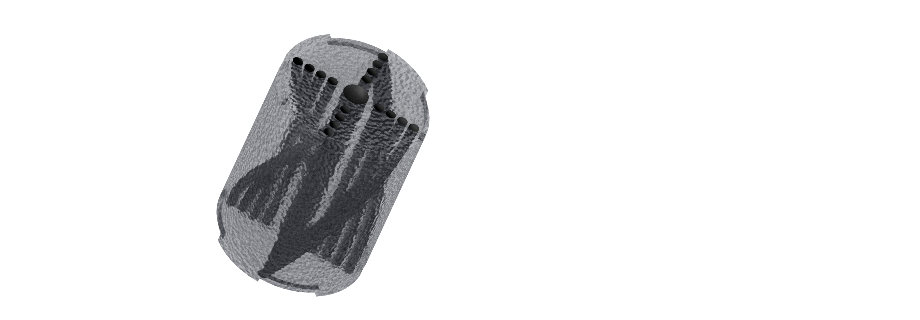
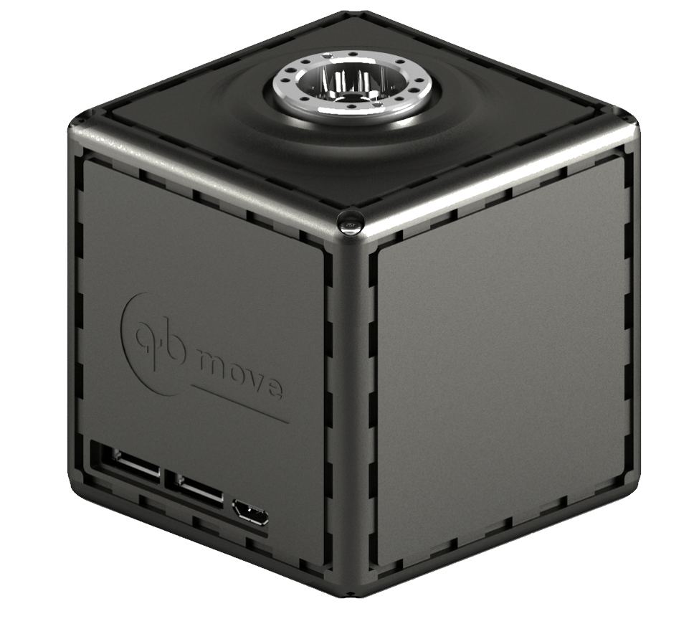
Design
The system module is designed according to a modular approach. The module is divided into 3 main parts:
Soft joint
Rigid junction
Actuation system
Rigid junction and soft component are designed to match and can be assembled to achieve a desired length for a soft manipulator.
Soft joint are composed by 3D printed soft material charaterized by elastic and viscous properties. Rigid junction is composed by rigid material like plastic.
Both rigid and soft parts have 16 holes that permit steel wire tendons to pass trough. Inner holes contain curvature tendos made of while the outer ones contain twisting tendons.
Actuation system is concentrated at the bottom of the structure and carry on the task to push and pull the wires using a pulley system. VSA actuators like qbmove can be used.

Slide 5
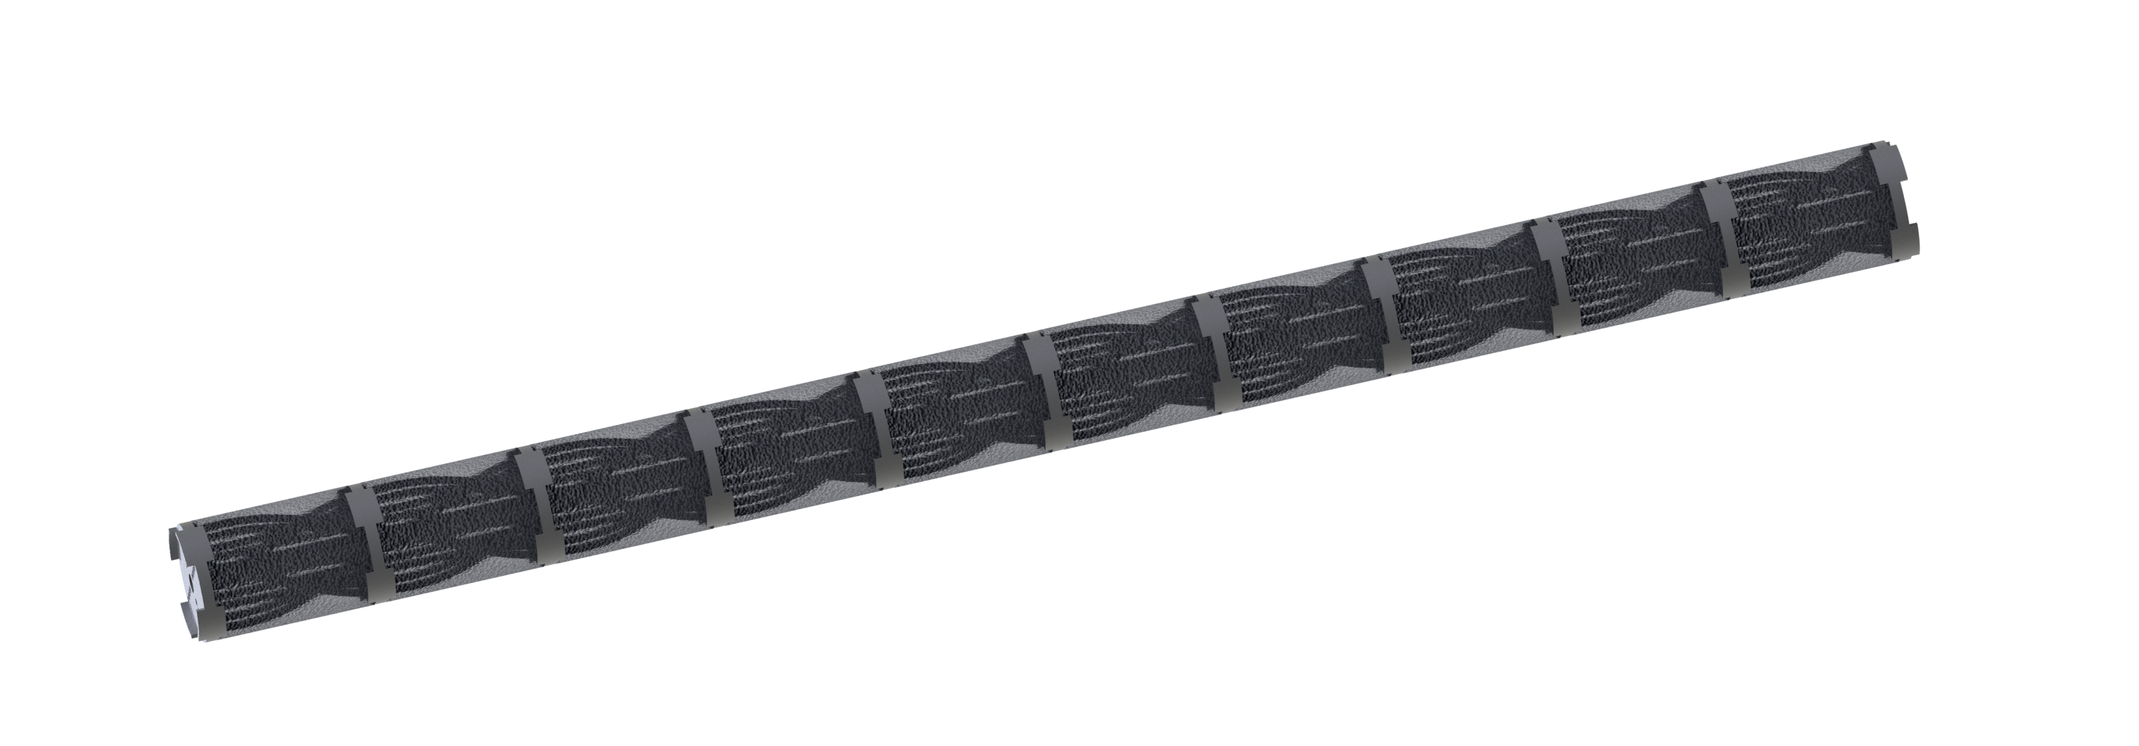
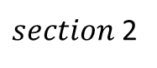
Design
Once defined the main components, the section can be assembled: each module is connected on the bottom of the next and the threads run inside. For each section 8 wires are needed and are knotted on the top of the structure.
Another inner wire on the main hole can be knotted to keep the structure under tension.
A complete manipulator can be composed by 2 sections and driven by 6 actuators.
The actuation system is located on the bottom of the structure and holds the pulleys and motors that drive the movements of the cables.
When the motors applies torque on cable head is pulled and the other head is released so a momentum can be generated on the top of the structure .
$section$2
$$section 1$$
The analyzed case takes in to account a continuum robot composed by 2 sections and 6 actuations. Every section measures 0.4m .

Slide 6
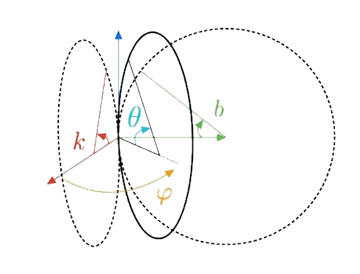
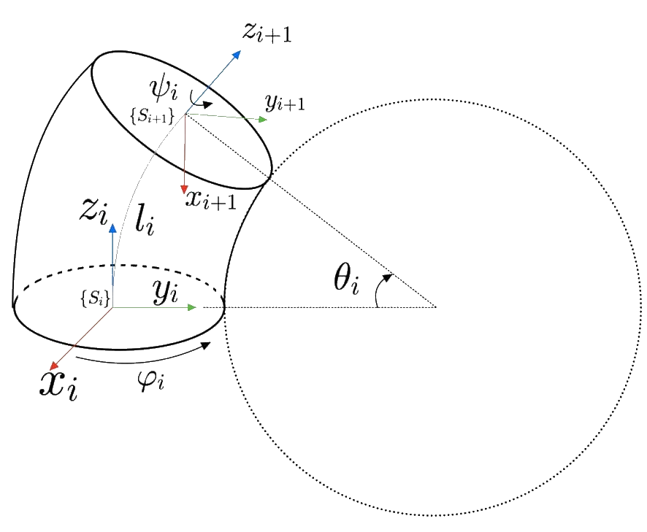
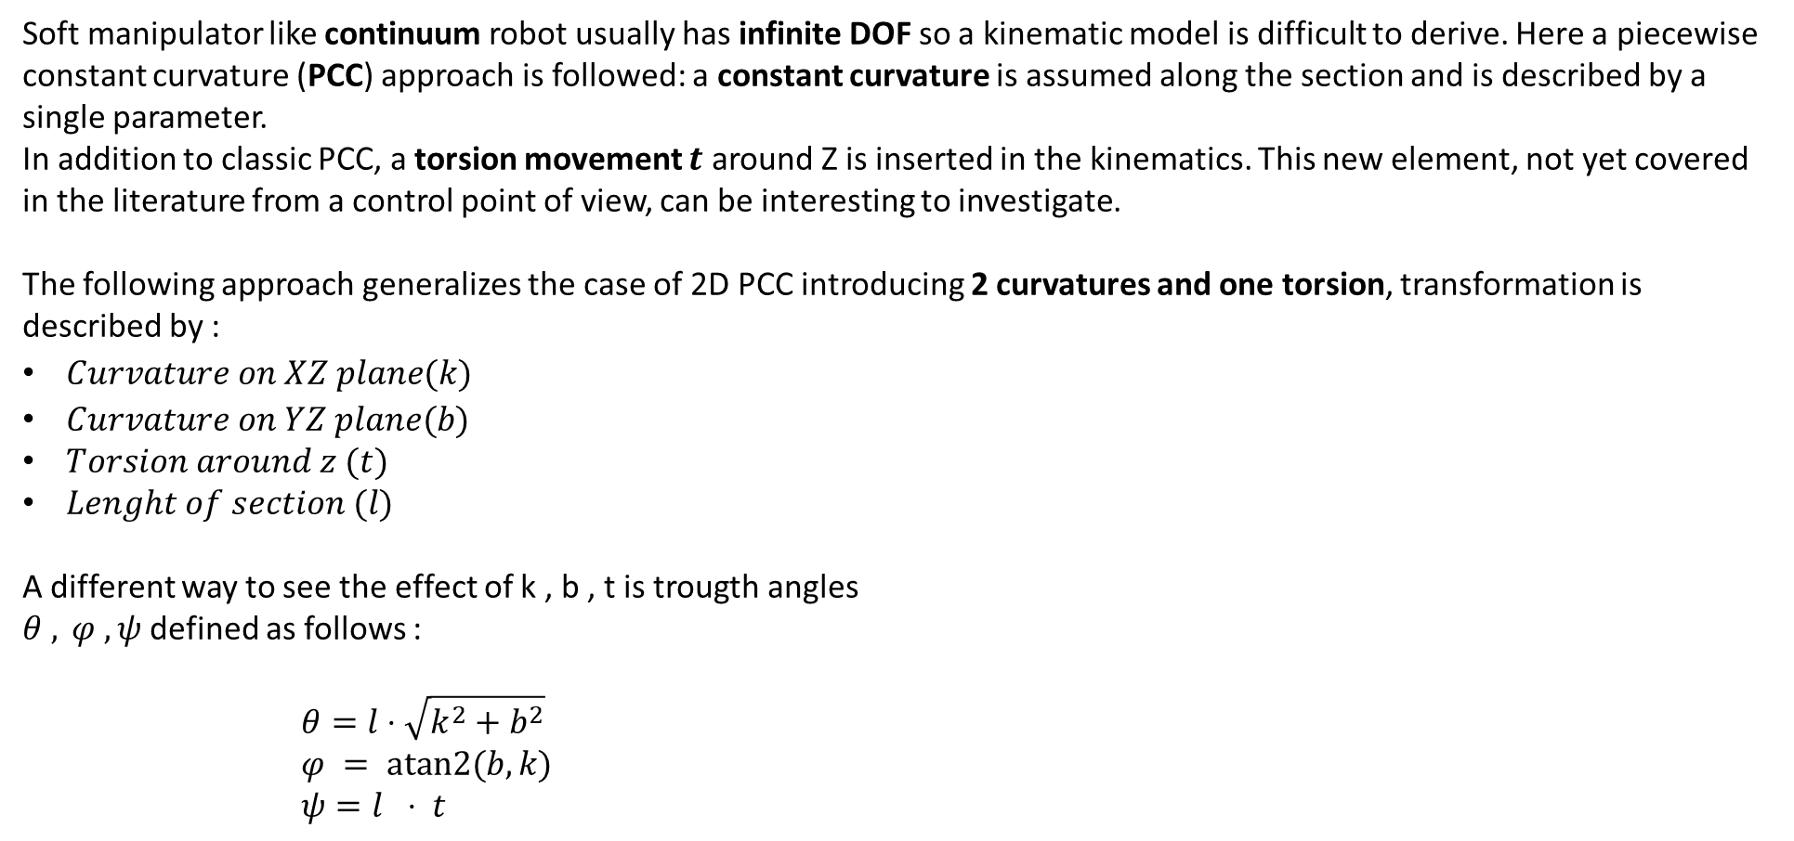
kinematics
Soft manipulator like continuum robot usually has infinite DOF so a kinematic model is difficult to derive. Here a piecewise constant curvature (PCC) approach is followed: a constant curvature is assumed along the section and is described by a single parameter.
In addition to classic PCC, a torsion movement $t$ around Z is inserted in the kinematics. This new element, not yet covered in the literature from a control point of view, can be interesting to investigate.
The following approach generalizes the case of 2D PCC introducing 2 curvatures and one torsion, transformation is described by :
$Curvature on XZ plane (k)$
$Curvature on YZ plane (b)$
$Torsion around z (t)$
$Lenght of section (l)$
A different way to see the effect of k , b , t is trougth angles
$θ , φ , ψ$ defined as follows :
$$θ=l⋅\sqrt{k^{2}+b^{2}}$$
$$φ = atan2(b,k)$$
$$ψ=l ⋅ t$$

Slide 7
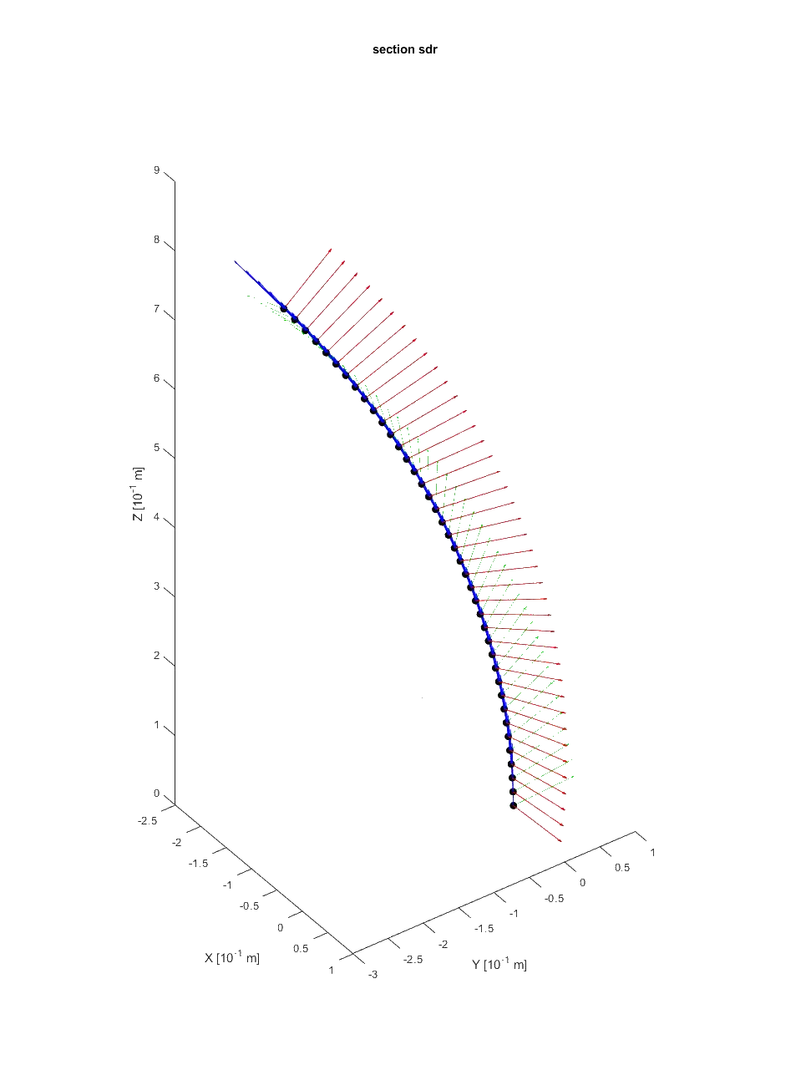
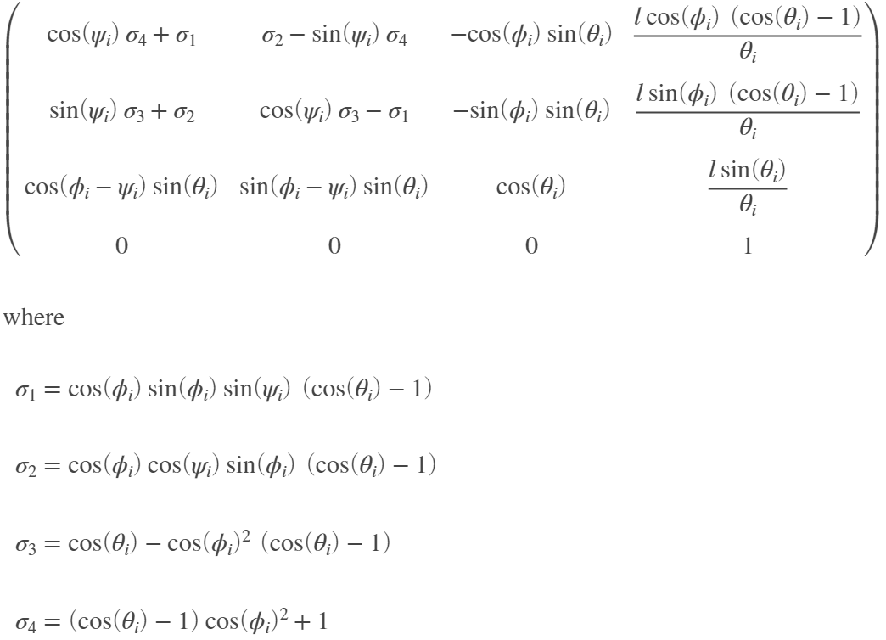
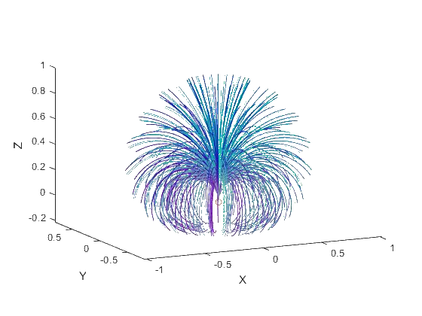
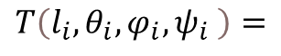
kinematics
Using previously defined parameters homogeneous transformation matrix from frame $\{S_{i}\}$to frame {$S_{i+1}$} can be defined as follows :
$$T\left({l_{i},θ}_{i},φ_{i},ψ_{i} \right)=$$

Slide 8
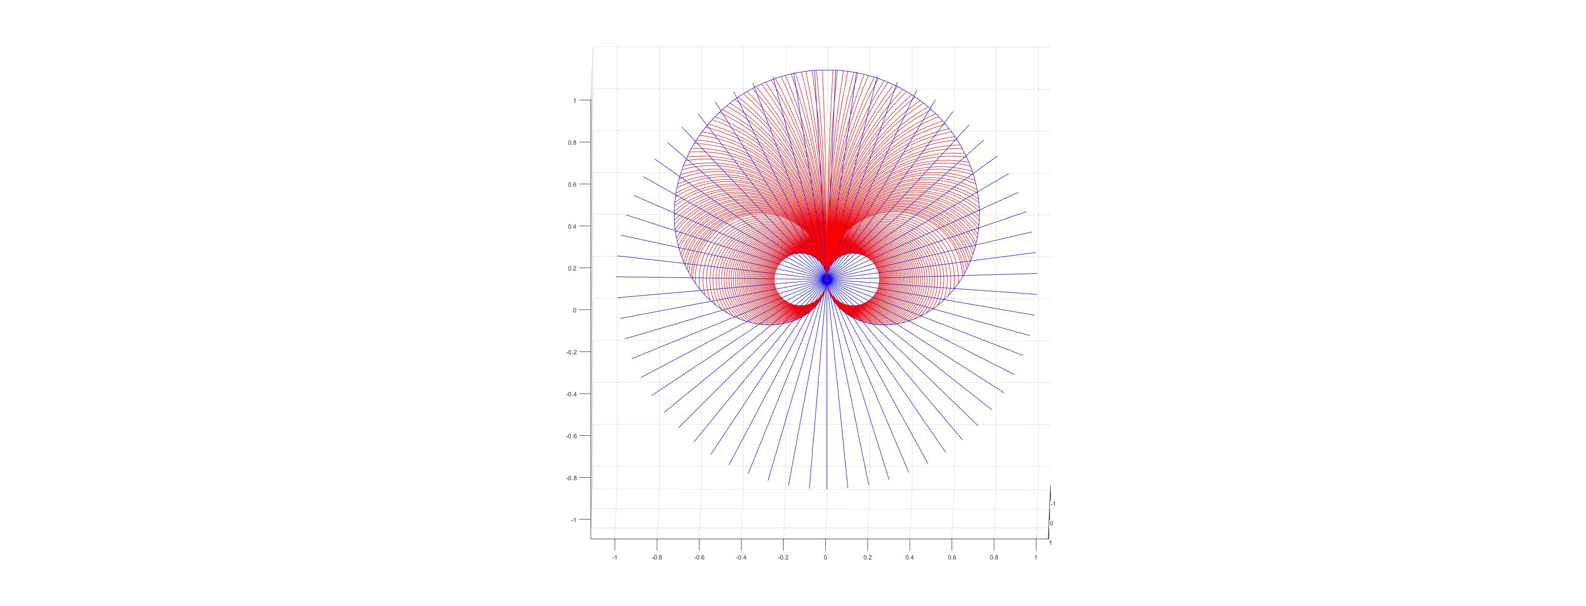
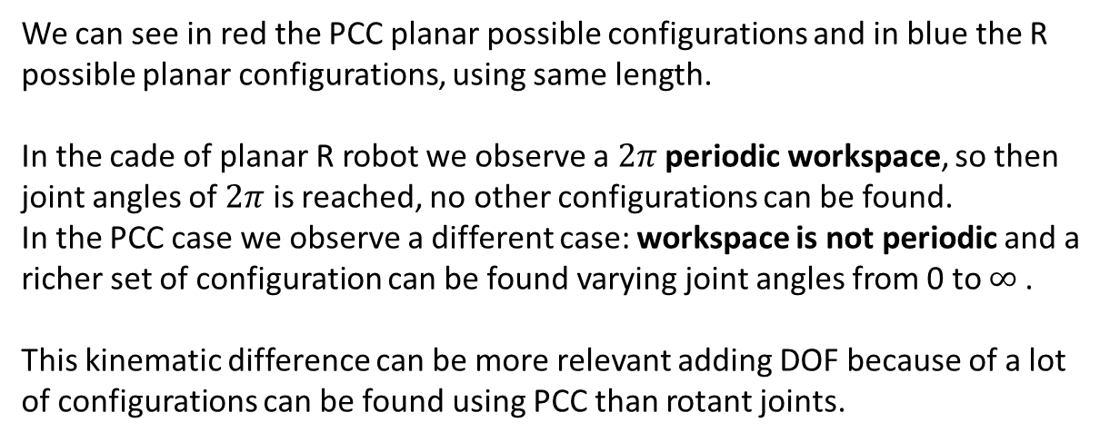
kinematics
To compare kinematics behavior of PCC and rigid we have to set up a comparison method. The
planar case can be explanatory.
R planar case and PCC case are here compared:
We can see in red the PCC planar possible configurations and in blue the R possible planar configurations, using same length.
In the cade of planar R robot we observe a $2π$ periodic workspace, so then joint angles of $2π$ is reached, no other configurations can be found.
In the PCC case we observe a different case: workspace is not periodic and a richer set of configuration can be found varying joint angles from 0 to $∞$.
This kinematic difference can be more relevant adding DOF because of a lot of configurations can be found using PCC than rotant joints.

Slide 9
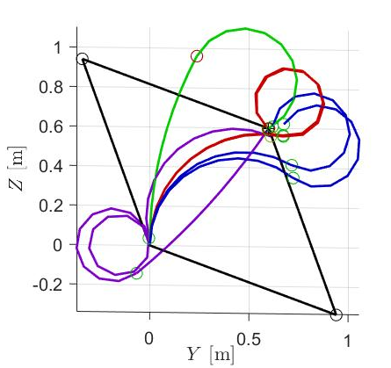
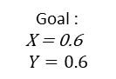
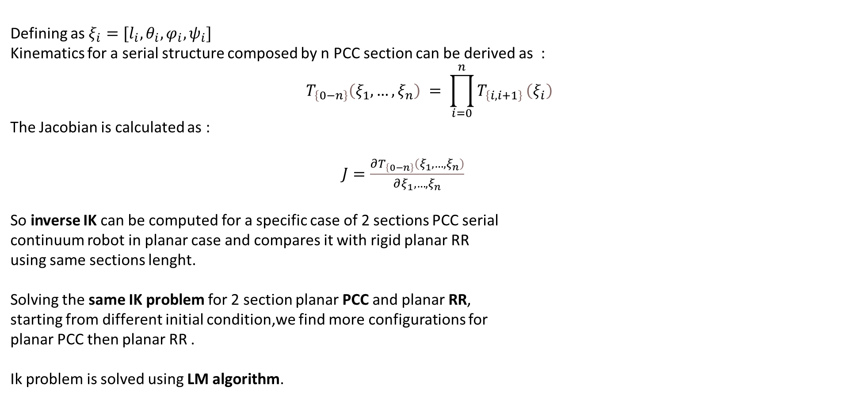
kinematics
Defining as $ξ_{i}=[l_{i},θ_{i},φ_{i},ψ_{i}]$
Kinematics for a serial structure composed by n PCC section can be derived as :
$$T_{\left\{0−n\right\}}\left(ξ_{1}, …,ξ_{n}\right) = \prod_{i=0}^{n}{T_{\left\{i,i+1\right\}}}\left(ξ_{i}\right)$$
The Jacobian is calculated as :
$J=\frac{∂T_{\left\{0−n\right\}}\left(ξ_{1}, …,ξ_{n}\right)}{∂ξ_{1}, …,ξ_{n}}$
So inverse IK can be computed for a specific case of 2 sections PCC serial
continuum robot in planar case and compares it with rigid planar RR
using same sections lenght.
Solving the same IK problem for 2 section planar PCC and planar RR,
starting from different initial condition,we find more configurations for
planar PCC then planar RR .
Ik problem is solved using LM algorithm.
Black :
RR configuration 1
RR configuration 2
Blue red green magenta :
Configurations planar 2
dof PCC starting from different initial condition
Yellow : goal
Goal :
X = 0.6
$$Y=0.6$$

Slide 10
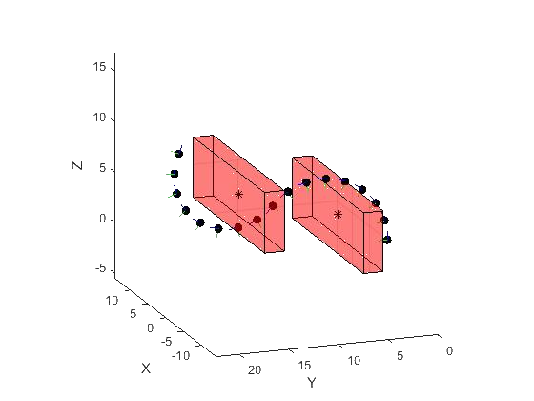
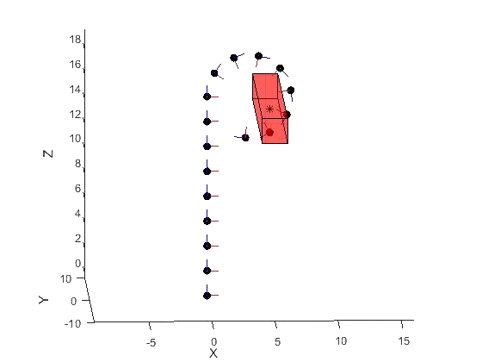
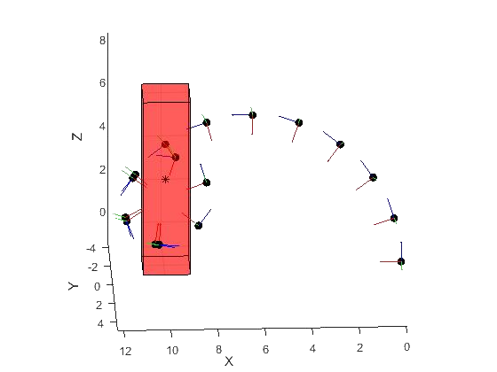
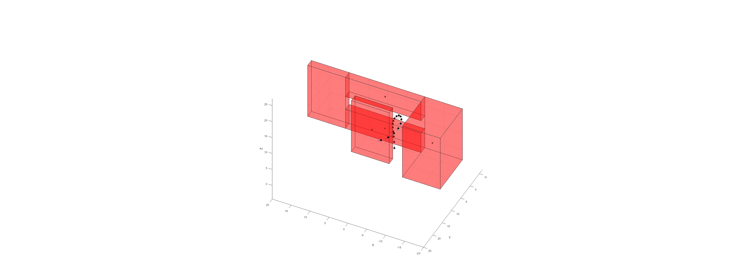
kinematics
Defined the homogeneous transformation matrix from frame $\{S_{0}\}$to frame {$S_{2}$}, we can make some considerations and comparisons about soft PCC and RR. In particular, observing the behavior of kinematics, we find a set of tasks in which soft PCC is more suitable than rigid manipulator :
Constrain space task
1 DOF grasping
Dynamics of soft PCC section and the passive softness can be used in constrains space. Allowing robot to colliding with obstacle, the pose can be modified without damaging the world around.
Grasping tasks
Tasks that implies collision with obstacles

Slide 11
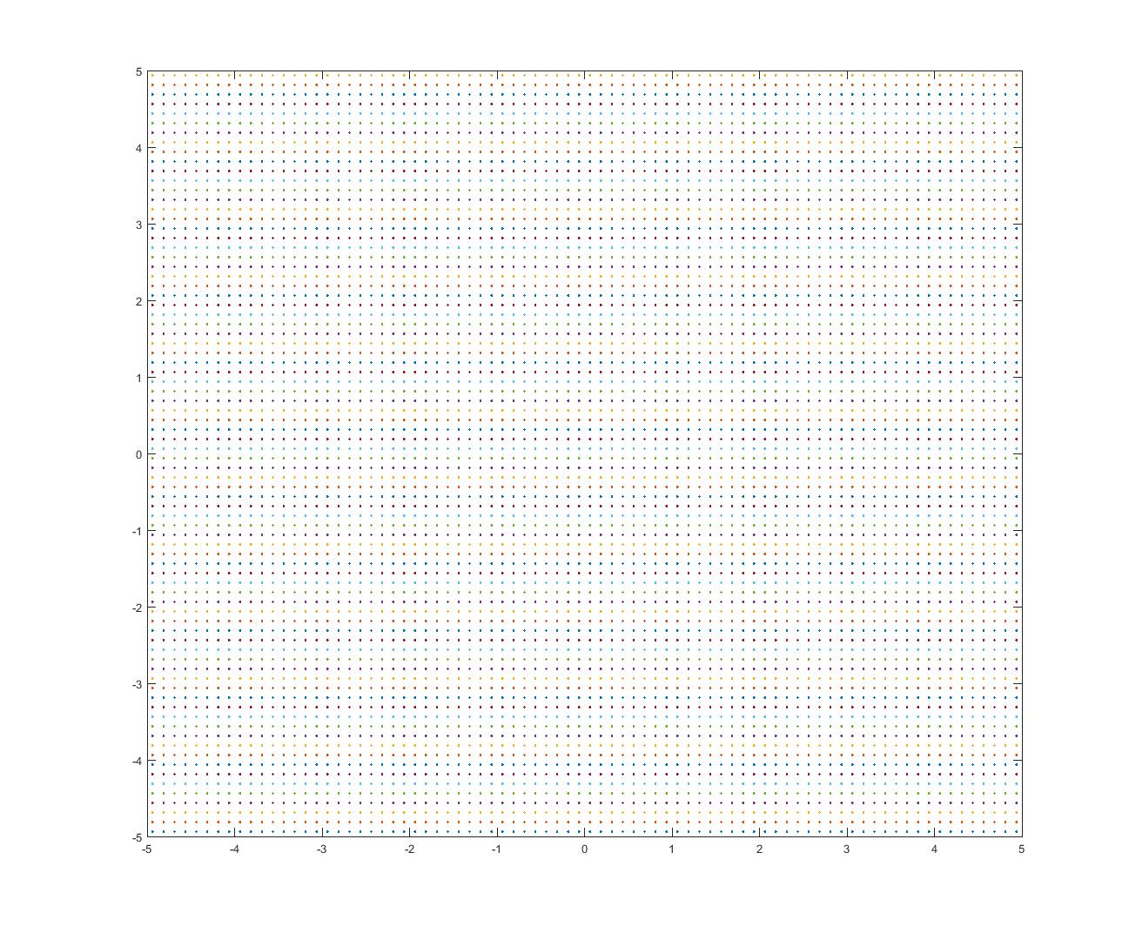
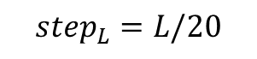
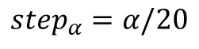
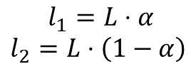
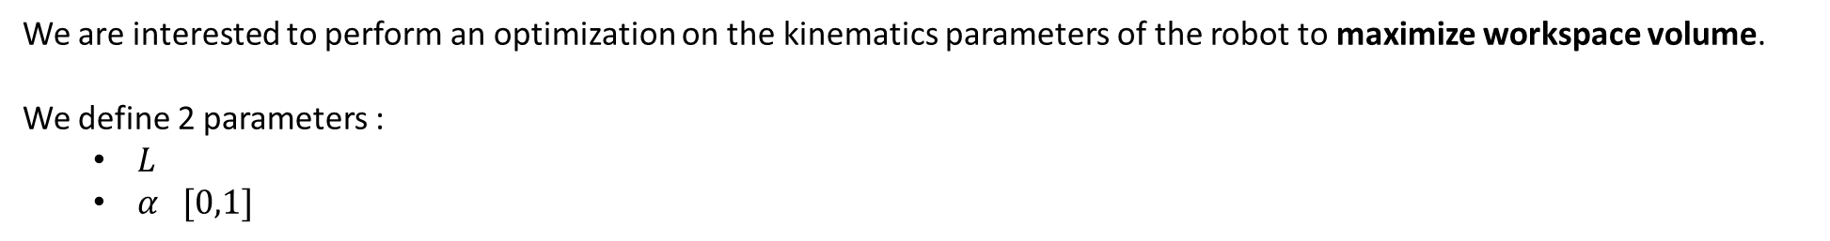
Workspace analysis
We are interested to perform an optimization on the kinematics parameters of the robot to maximize workspace volume.
We define 2 parameters :
$L$
$α [0,1]$
$$l_{1}=L⋅α$$
$$l_{2}=L⋅\left(1−α\right)$$
The optimization framework consists of an analysis of a finite number of points in a 2D grid, IK algorithm is launched for every point of the grid and return 1 if the point is reachable with acceptable error, 0 otherwise.
The grid has 1600 points, and the points span on X,Y from -5 to + 5.
L is chosen to vary from 1m to 5m.
IK calculation is performed for every point of the grid for every alpha end for every length with :
$$step_{L}=L/20$$
20^2 trials of L and alpha are performed .
$$step_{α}=α/20$$

Slide 12
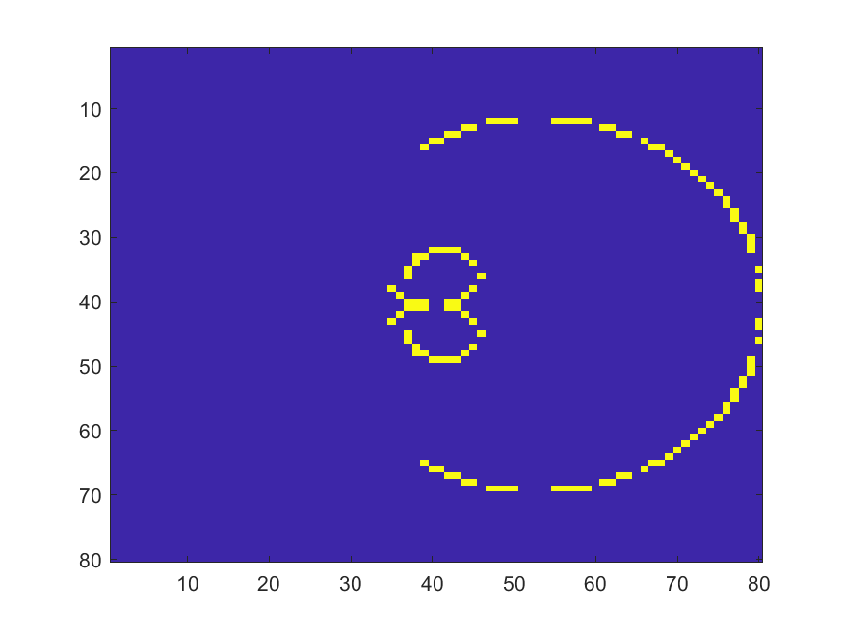
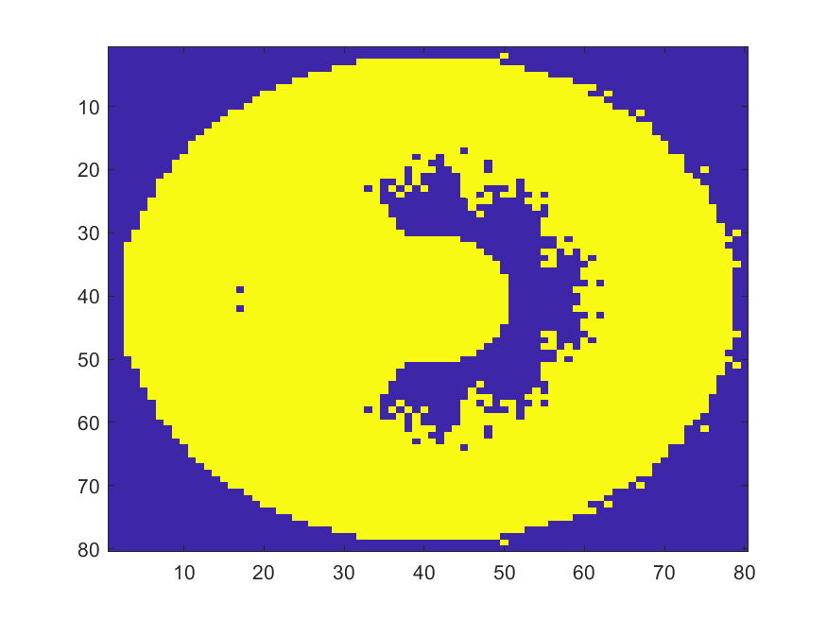
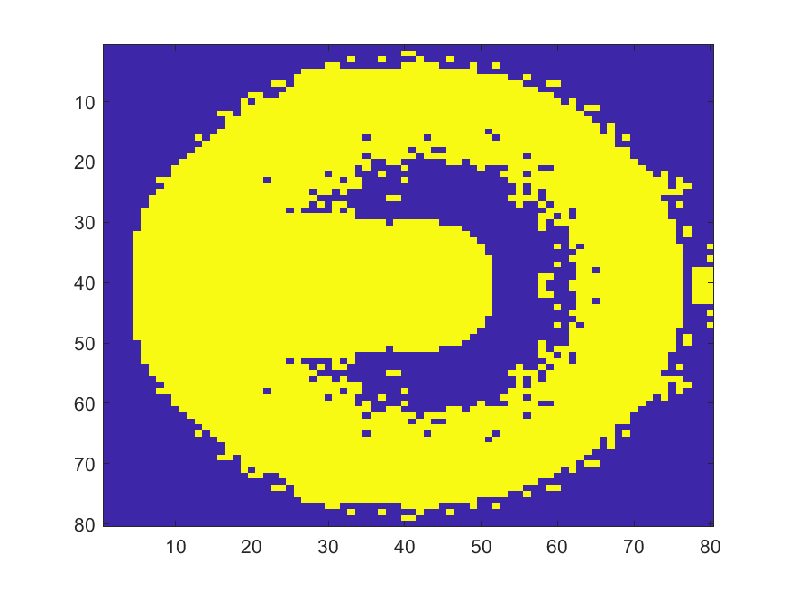
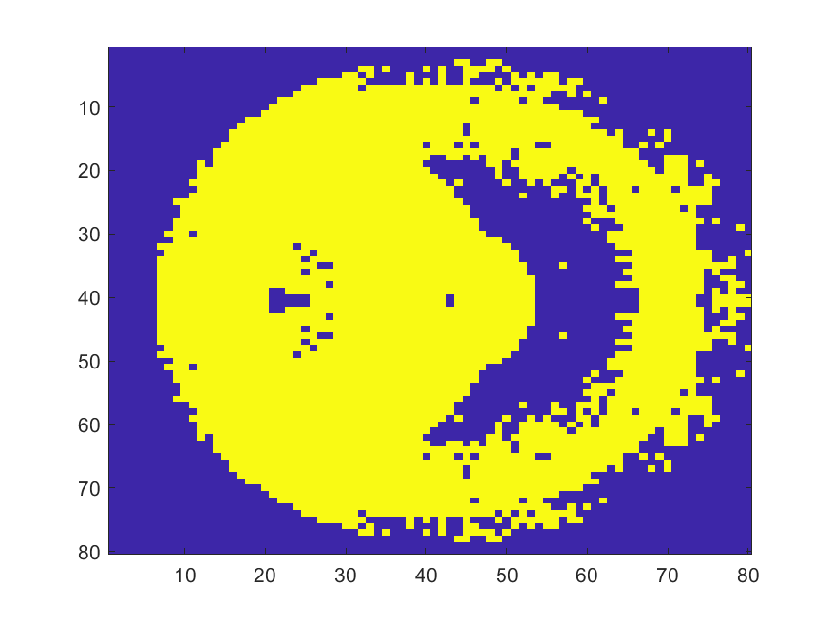
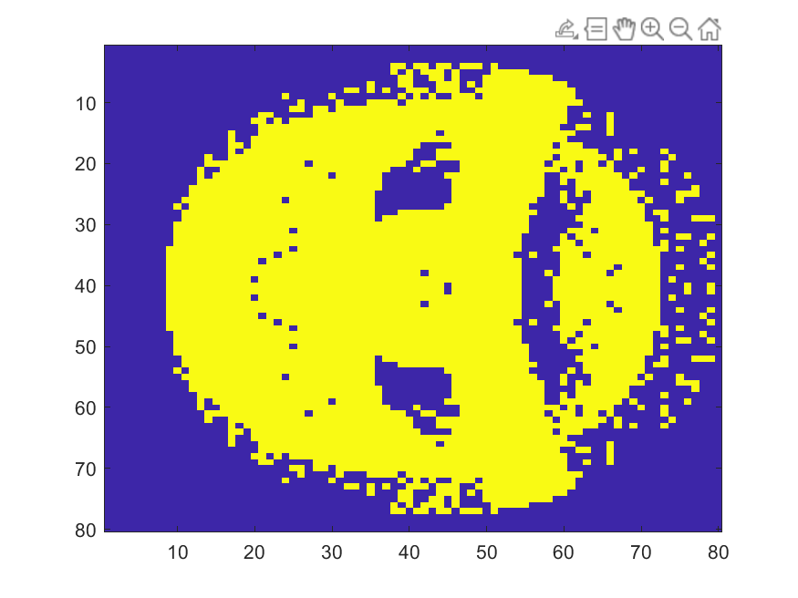
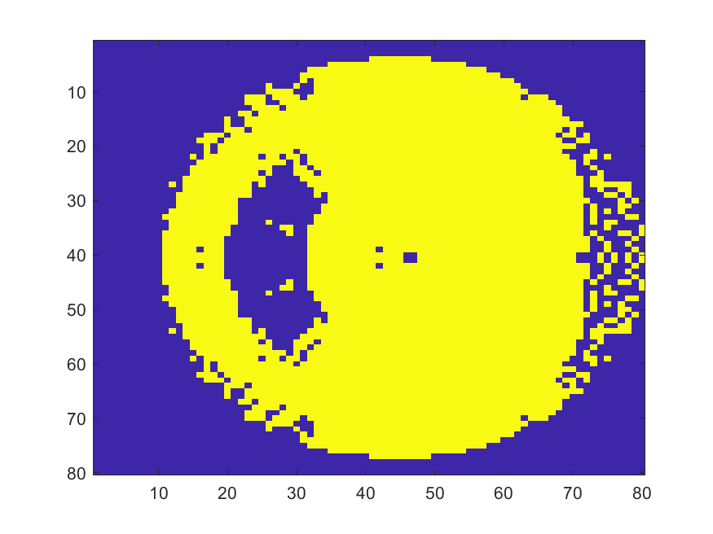
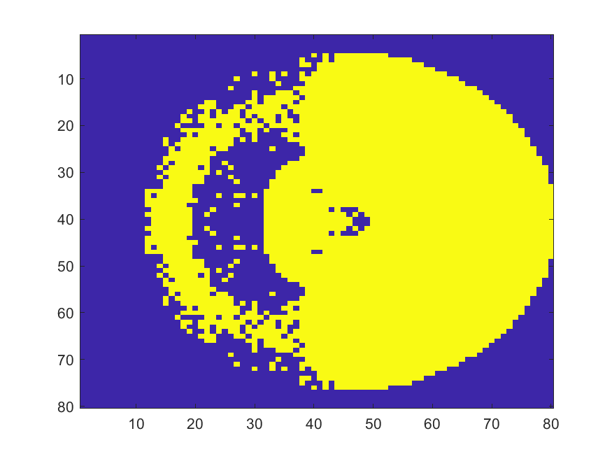
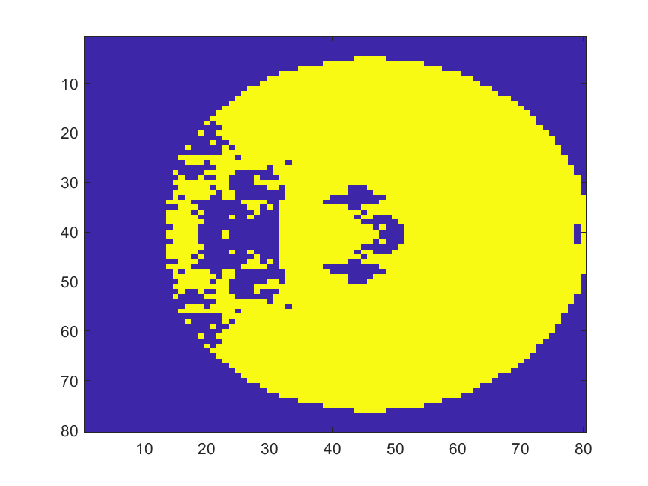
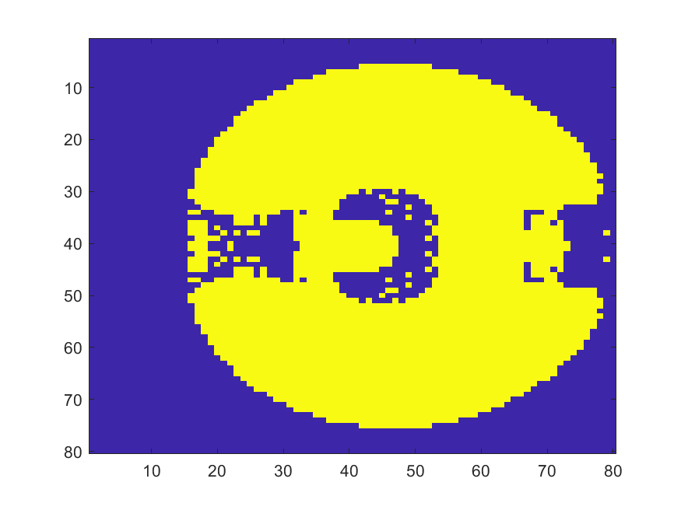
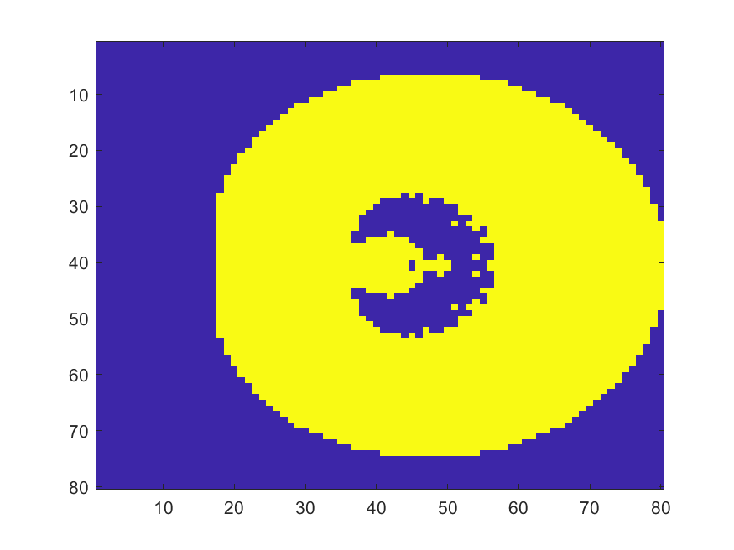
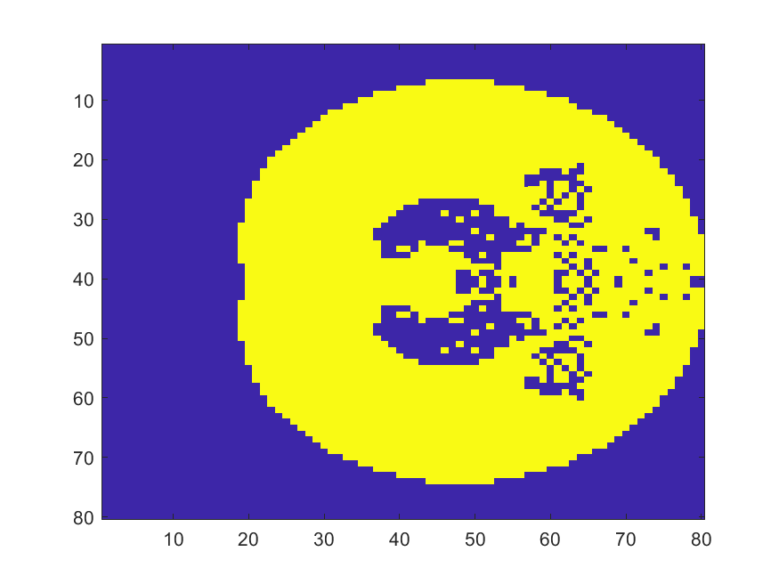
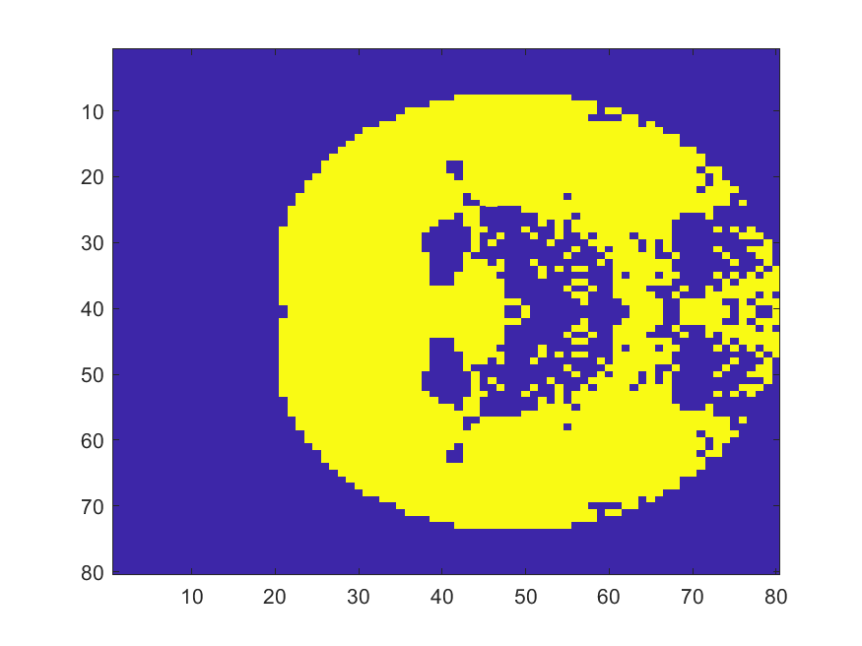
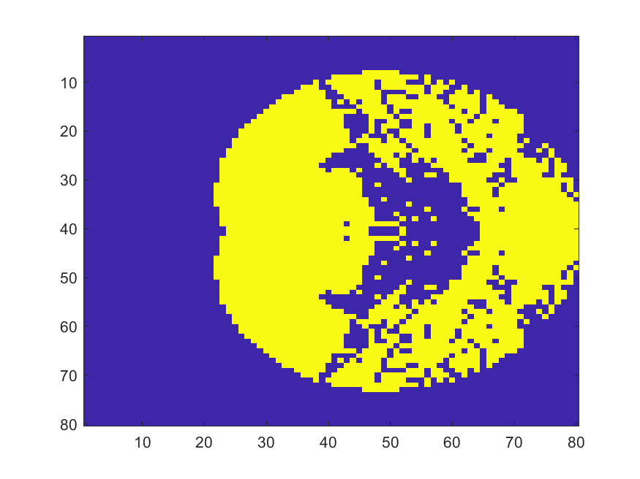
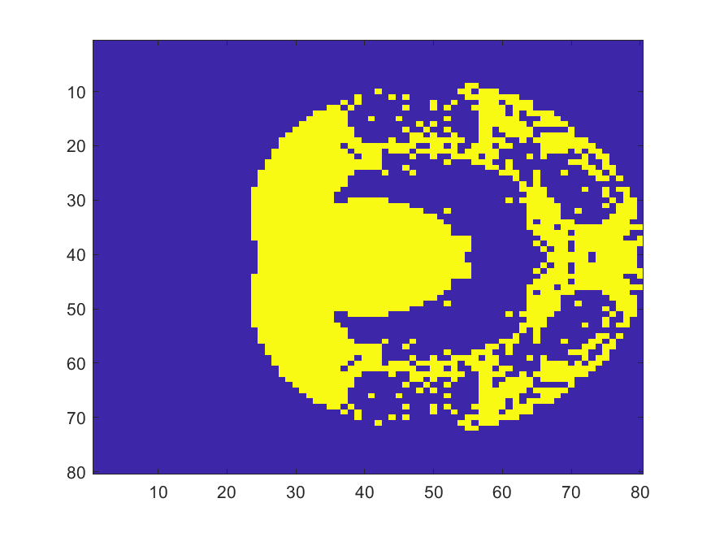
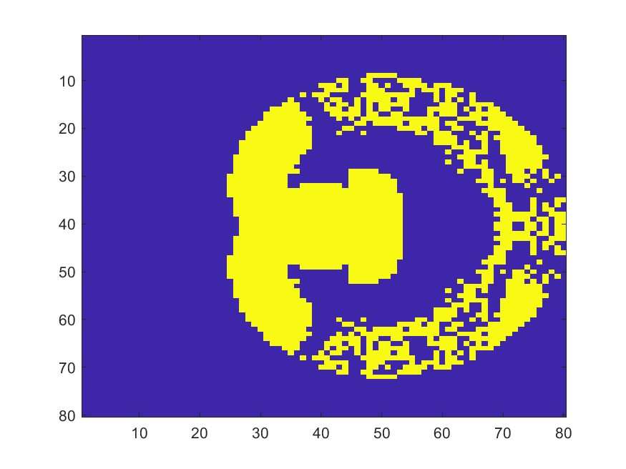
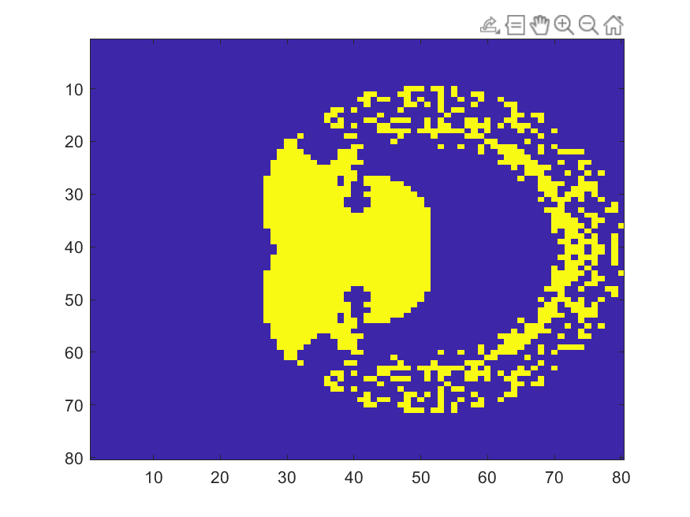
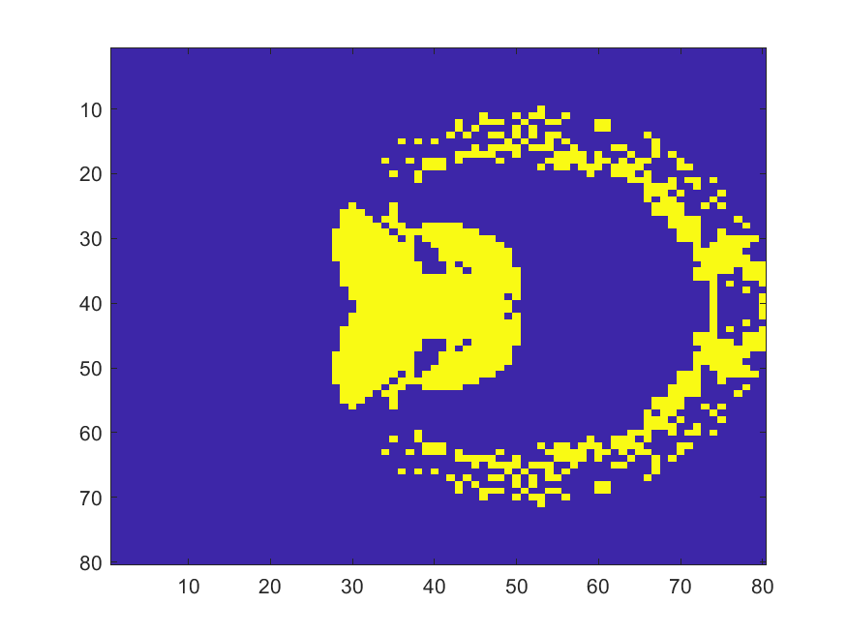
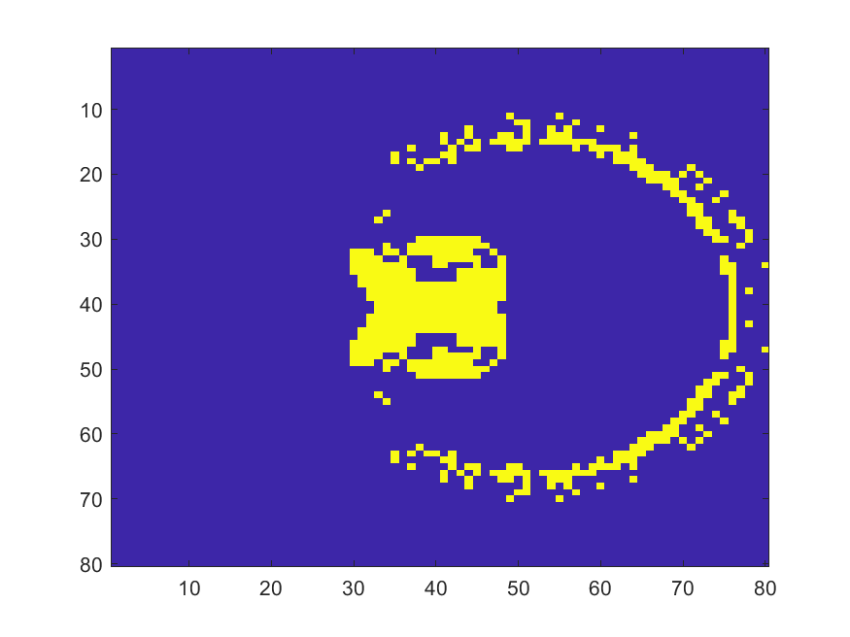
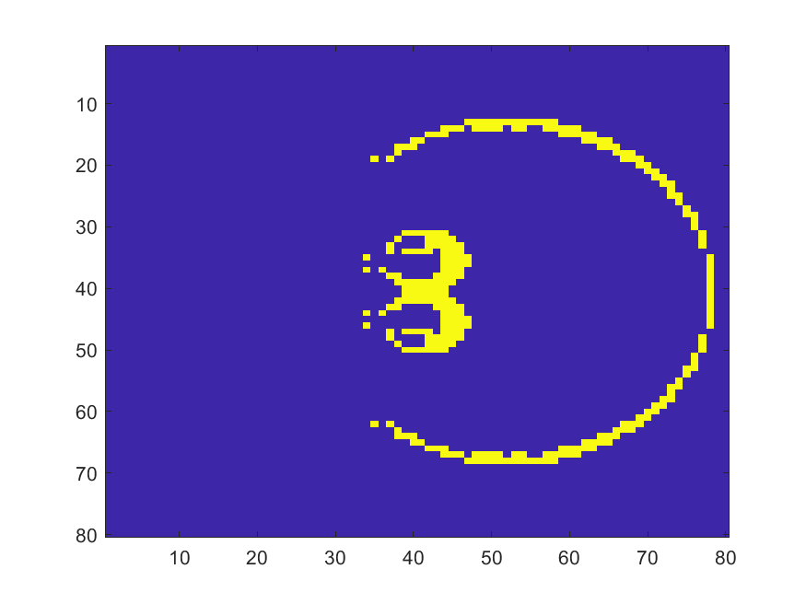
Workspace analyses
After generation , raw data are presented. Limit case for$α=1$and $α=0$are outlier and have been cut in fitting .
At fixed length we can inspect data as alpha changes :

Slide 13
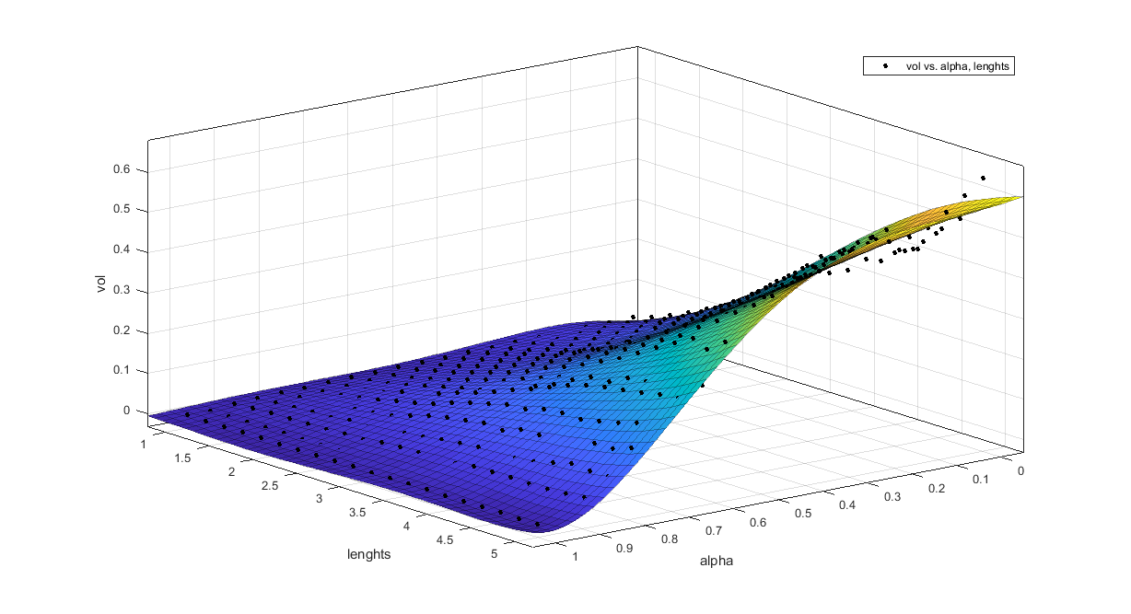
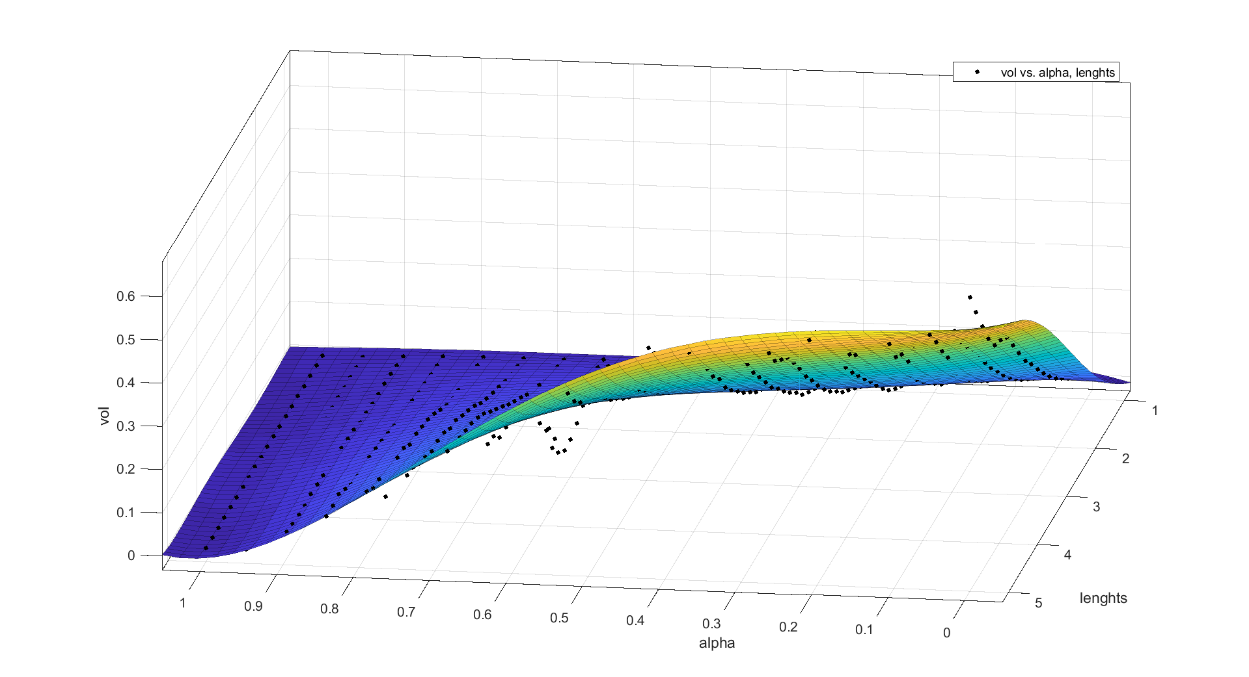
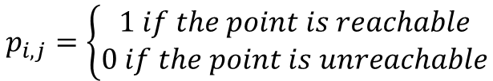

Workspace analyses
We define a index of volume of the workspace as sum of elements of the generated matrix ad fixed length end alpha.
$Vol=\frac{\sum_{i=1}^{N}{\sum_{i=1}^{N}{p_{i,j} } }}{N^{2}}$
$$p_{i,j}=\left\{\begin{matrix}1 if the point is reachable \\ 0 if the point is unreachable\end{matrix}\right.$$
Compute volume for every trial of $α$ and $L$ we obtain 400 points and we can fit data to find the volume as a function of $L$ and $α$ . Polynomial function is chosen to perform the fitting.

Slide 14


Workspace analyses
Zone 1
Zone 2
Zone 3
Linear model Poly55:
f(x,y) = p00 + p10*x + p01*y + p20*x^2 + p11*x*y + p02*y^2 + p30*x^3 + p21*x^2*y
+ p12*x*y^2 + p03*y^3 + p40*x^4 + p31*x^3*y + p22*x^2*y^2
+ p13*x*y^3 + p04*y^4 + p50*x^5 + p41*x^4*y + p32*x^3*y^2
+ p23*x^2*y^3 + p14*x*y^4 + p05*y^5
where x is normalized by mean 0.5 and std 0.3039
and where y is normalized by mean 3 and std 1.215
Coefficients (with 95% confidence bounds):
p00 = 0.1616 (0.157, 0.1663)
p10 = -0.06982 (-0.07898, -0.06066)
p01 = 0.1292 (0.12, 0.1383)
p20 = -0.02852 (-0.03563, -0.02142)
p11 = -0.07506 (-0.08086, -0.06927)
p02 = 0.0173 (0.0102, 0.0244)
p30 = -0.01237 (-0.02284, -0.001908)
p21 = -0.02793 (-0.03601, -0.01984)
p12 = -0.01717 (-0.02526, -0.009085)
p03 = -0.007748 (-0.01821, 0.002718)
p40 = 0.007998 (0.005442, 0.01056)
p31 = 0.004959 (0.002769, 0.007148)
p22 = -0.007 (-0.009137, -0.004864)
p13 = 0.003761 (0.001571, 0.00595)
p04 = 0.001055 (-0.001502, 0.003612)
p50 = 0.002154 (-0.0008798, 0.005188)
p41 = 0.007392 (0.004832, 0.009952)
p32 = 0.005376 (0.002916, 0.007836)
p23 = -0.00237 (-0.00483, 9.04e-05)
p14 = 0.000364 (-0.002196, 0.002924)
p05 = 0.001878 (-0.001156, 0.004912)
Goodness of fit:
SSE: 0.1117
R-square: 0.988
Adjusted R-square: 0.9874
RMSE: 0.01717
We can identify 3 main zone : in zone 1 we have a very small volume, in zone 2 we have a volume that increases linearly respect alpha, in zone 3 we have a sort of saturation and increasing alpha we have small changes in volume.
We observe that the volume increases linearly with $L$and is maximized for
approximately $α = 0.2$.

Slide 15

dynamics
For dynamics evaluation lagrangian approach is proposed. Using this method closed form can be found and used in phase of control and stability considerations .
Lagrangian approach can be usefull for taking in to account conservative elastic force trought energetic considerations.
Using this approach we indirectly assume (to simplify) that valid configurations for the soft robot are strictly correlated to $k_{i},b_{i},t_{i}$ , this is not true in general (expecially for soft robots) because of external forces can modify the local pose and generate internal non conservative forces.
Some parameter definitions and hypotesis are needed to go on :
${Gs}_{i} − Shearing modulus$
$I_{i} − Inertia diagonal matrix$
$m_{i} − Mass of segment i supposed concentrated in \{S_{i+1}\}$
$D_{i} − damping matrix of section i caused by viscous forces$
$q_{i}=\left[k_{i};b_{i};t_{i}\right]−are used as joints variables$
${W_{i}}_{ext} – external forces and momentum$
$τ –joints torque$
$All computation are done in frame \{S_{0}\}$

Slide 16


dynamics
mass matrix can be computed as :
$$M_{i_{\left\{S_{i}\right\}}}=\left[\begin{matrix}m_{i}⋅eye(3) & 0 \\ 0 & I_{i}\end{matrix}\right]$$
So Inertial matrix is derived :
$$B_{i}=J_{i}^{T}⋅M_{i_{\left\{S_{0}\right\}}}⋅J_{i} and B= \sum_{i}^{n}{B_{i}}$$
Potential gravitational energy :
$$Ug_{i}=−m_{i}⋅g⋅p_{i_{z}}$$
Elastic potential energy :
$$U_{e}=\frac{1}{2}⋅q_{i}^{T}⋅\left(\begin{matrix}E_{i} & 0 & 0 \\ 0 & E_{i} & 0 \\ 0 & 0 & Gs_{i}\end{matrix}\right)⋅q_{i} and U=\sum_{i}^{n}{{Ue}_{i}+Ug_{i}}$$
Kinetic energy :
$$T=\frac{1}{2}⋅\dot{q_{i}^{T}}B_{i}⋅\dot{q_{i}} and T=\sum_{i}^{n}{T_{i}}$$

Slide 17

dynamics
Finally lagrangian can be written :
$L(\dot{q,}q,t)=T(\dot{q,}q,t)−U(q,t)$
Using cristoffel symbols dynamichs matrixs B,C,G are derived. A damping matrix D is introduced to take into account the viscous effects of the material.
Closed form for dynamichs can be written as :
Given dynamichs we can rewrite dynamichs :
In 2 section case $q= {\left[\begin{matrix}k_{1} & b_{1} & \begin{matrix}t_{1} & k_{2} & \begin{matrix}b_{2} & t_{2}\end{matrix}\end{matrix}\end{matrix}\right]}^{T}$
$$B\left(\dot{q},q\right)⋅ \ddot{q}+C\left(\dot{q},q\right)⋅\dot{q}+G\left(q\right)+D⋅\dot{q}=τ+J^{T}⋅W_{ext}$$
$$\ddot{q}=−B{\left(\dot{q},q\right)}^{−1}⋅( C\left(\dot{q},q\right)⋅\dot{q}+G\left(q\right)+D⋅\dot{q}−τ−J^{T}⋅W_{ext})$$

Slide 18








Stability analysis
The goal is to find range of values of $E− Young’s Modulus$ that allow the system to be stable, subject to gravitational force.
The consideration can be done in planar case and observing the behavior of a single section so considering $q=\left[k_{1}\right]$ and fixing parameters as follows :
m = 0.05
Iy = 10^-6
g = - 9.8
L = 0.4
D = 0.001
The derivation of dynamics is similar to previously described. Linearization can be performed in equilibrium for $k_{1,}\dot{k_{1,}}=0$ so dynamichs matrix $A(E_{1})$is obtaind:
$$A\left(E\right)=$$
$$with eingvalues$$
$$λ=$$

Slide 19




Stability analysis
A condition for E is found imposing $λ_{1} , λ_{2}<0$ a limit condition for $E$ in this case is found as $E > 1.08⋅{10}^{4}$. Limit condition is strongly influenced by other parameters. In general, the more E is increased (in reasonable way) the more system is stable.

Slide 20



Single section dynamics
We are interested to evaluate the behavior of a single section subjected to draft forces of the wires.
Since we have not rigid joints we have to consider ingress u as a resultant external forces exerted by the cables to the rigid junction.
$$U_{\left\{S_{0}\right\}} =\left[0;0;0,M_{x},M_{y},M_{z}\right] in sdr \left\{S_{0}\right\}$$
$$U_{\left\{S_{1}\right\}}=\left[\begin{matrix}R_{\left\{S_{0}−S_{1}\right\}} & 0 \\ 0 & R_{\left\{S_{0}−S_{1}\right\}}\end{matrix}\right]⋅U_{\left\{S_{0}\right\}}$$
$$τ=J^{T}⋅U_{\left\{S_{1}\right\}}$$
Our control variables are $u_{1}=M_{x} ; u_{2}=M_{y} and u_{3}=M_{z}$ . Control is mapped by a nonlinear function in accelerations on joints variables$\ddot{ q}$.
$$\ddot{q}=−B{\left(\dot{q},q\right)}^{−1}⋅( C\left(\dot{q},q\right)⋅\dot{q}+G\left(q\right)+D⋅\dot{q}−τ−J^{T}⋅W_{ext})$$

Slide 21





Single section dynamics
We introduce a simulation setup to verify the theoretical behavior of the model. In particular we are interested to investigate:
bindind between $τ\left(q\right)−\ddot{q}$
bindind between $\ddot{k}−\ddot{b}−\ddot{t}$ .
behavior as the stiffness varies
Free evolution
Starting from $k_{0}=1$, planar motion on XZ plane can be observed, there aren’t any interactions with other variables.
Starting from $K_{0} =\frac{pi}{2}$ and $t_{0}=\frac{pi}{4}$a binding between $k,b,t$can be observed.
In this system, when 2 state variables are different than zero, a binding occurs.

Slide 22




Single section dynamics
$$K_{0}=\frac{pi}{2}$$
$$b_{0}= 0$$
$$t_{0}=\frac{pi}{4}$$
Increasing E oscillations are higher and binding between variables is more visible.

Slide 23



Single section dynamics
Some tests applying $M_{x} M_{y} M_{z}$are performed using $E = 8⋅ {10}^{4}$.
Applying Mz for $t= 0s$we can see the evolution of t.
Mx was applied for $t=5s$and we can see the evolution of all 3 state variables $k,b,t$ .
Both variable state b and k are affected by Mx because of the initial orientation of the tip when momenum is applied

Slide 24


Control
In order to simplify the computation, 2 segment planar PCC is candidated for a control system design.
4 different controllers are proposed to carry on tasks of position control and trajectory control:
PD
PD + gravity compensation
PID
Inverted dynamics
Pd control
PD control system does not reach the goal of position control task because of gravity. To make this control system useful, gain K must be increased destroying the advantages of softness.

Slide 25




Control
Pd + gravity compensation control
The same control system as before is used introducing G compensation block inside control:
$$u= (K_{p}⋅e+k_{d}⋅ \dot{e}+G\left(q\right) )$$
Position control task is achieved using PD + gravity compensation control system.
Dynamics matrix G(q) is composed by 2 parts:
$G_{g}(q)$takes into account gravitational conseravitve forces
$G_{el}(q)$takes into account elastic conservative forces
We can select a partial compensation of conservative forces.

Slide 26

Control
PID
The same control system as before is used introducing integrative action inside control:
Using PID the system converge to the reference.
Integrative action make system slower to converge and the overshot is more accentuated than PD case.
Some better solutions can be found without integrative action.

Slide 27


Control
Inverted dynamics
For the trajectory control, inverted dynamics control is proposed. Using this method the choice of u is done following the dynamics of the system:
$$u=B\left(q\right)⋅y+n(q,\dot{q})$$
$$n\left(q,\dot{q}\right)=C\left(q,\dot{q}\right)⋅\dot{q}+D⋅\dot{q}+G(q)$$
$$y=r\left(t\right)−k_{p}⋅q−k_{d}⋅\dot{q}$$
Assuming perfectly known dynamics of manipulator reference joints acceleration $r(t)$ is perfectly followed by manipulator and acceleration error is negligible.

Slide 28


Control
Inverted dynamics
This approach is very useful for trajectory following in joint space and can be updated to trajectory following in operative space.
A perfect known dynamics is assumed so a very good control can be achieved, truly we have not perfectly known parameters so :
$$u^{′}=\hat{B\left(q\right)⋅}y+\hat{n(q,\dot{q})}$$
$$\hat{n(q,\dot{q})}=\hat{C\left(q,\dot{q}\right)}⋅\dot{q}+\hat{D}⋅\dot{q}+\hat{G\left(q\right) }$$
$$y=r\left(t\right)−k_{p}⋅q−k_{d}⋅\dot{q}$$
Introducing a little variaton (5%) in mass parameter
and in young moduls (2%) we obtain time increasing
tracking error that can even diverge over time.
So well known parameters are needed to follow this
control method.
Increasing gain the error can be containd, but the system becomes more rigid

Slide 29

Complete model and control
The 2 section model of continuum robot is developed using lagrangian dynamics and symbolic dynamics matrices are calculated.
Same control process as previously model is developed for complete model:
PD
PD + conervative forces compensation
Inverted dynamics

Slide 30


Complete model and control
PD

Slide 31

Complete model and control
PID

Slide 32

Complete model and control
PD+G

Slide 33




Complete model and control
Inverted dynamics
In ideal condition the acceleration error drops to zero following the acceleration reference.
We can see the error in $\ddot{q}$ following a constant reference and the corresponding $\dot{q}$ and $q$ dynamics.

Slide 34
Conclusion and considerations
Kinematics of the 3D PCC model can be interesting, but it needs to be supplemented with a dynamics part with an arbitrary number of modules.
During the development of the model computational problems have been met. Increasing the number of section direct computation of dynamics matrixes become unsustainable.
Dynamics for a single section has a computational sustainable closed form and can be used to compute forces robot-environment and see the effect of forces environment-robot.
Kinematics of PCC is richer than common rigid robot.
Introducing soft material in the structure, we can perform grasping tasks with a lower number of joints.
interaction with the environment are safer than rigid robots.
PCC joints dynamics is computational expansive and more complicated than common rigid joints.
PI+G controller can be good for position control system.
Trajectory following control system is hard to implement in presence of uncertainty.

Slide 35
Future works
Build a real continuum robot using new soft materials proposed.
Validate proposed multi section model kinematics through experiments.
Validate dynamics model and control.
Make consideration and eventually correction of the model observe the behavior in a real case scenario.
Carry out some tasks (grasping, movements in restricted environment).

Slide 36
End of the presentation

